Slide 1

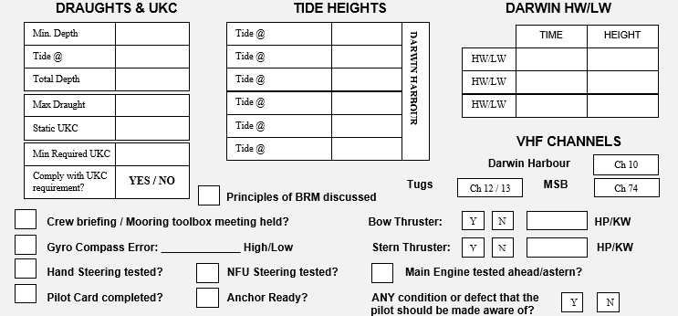
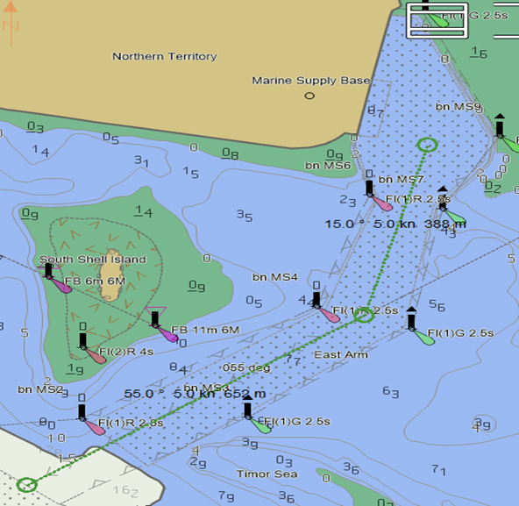

MSB PASSAGE PLAN
PIL-PP-12
Partnering in growth, connecting people and supporting potential
NAME OF VESSEL: ___________________________________ DATE: _____________________
POB TIME: ____________________ GT:__________________ DRAUGHT F: _______________
BERTH : ______________________ LOA:_________________ DRAUGHT A: _______________
STARBOARD SIDE ALONGSIDE
MANOEUVRE:
Transits of the Darwin Marine Supply Base channel are subject to tidal constraints and must be conducted in accordance with Port Notice PN/019
015°/ 195°
055° / 235°
THE PRINCIPLES OF BRIDGE RESOURCE MANAGEMENT MUST BE ADHERED TO AT ALL TIMES
MASTER:___________________________________ SIGNATURE:___________________________
PILOT:_____________________________________ SIGNATURE:___________________________
Teamwork | Respect | Integrity | Honesty | Safety

Slide 2
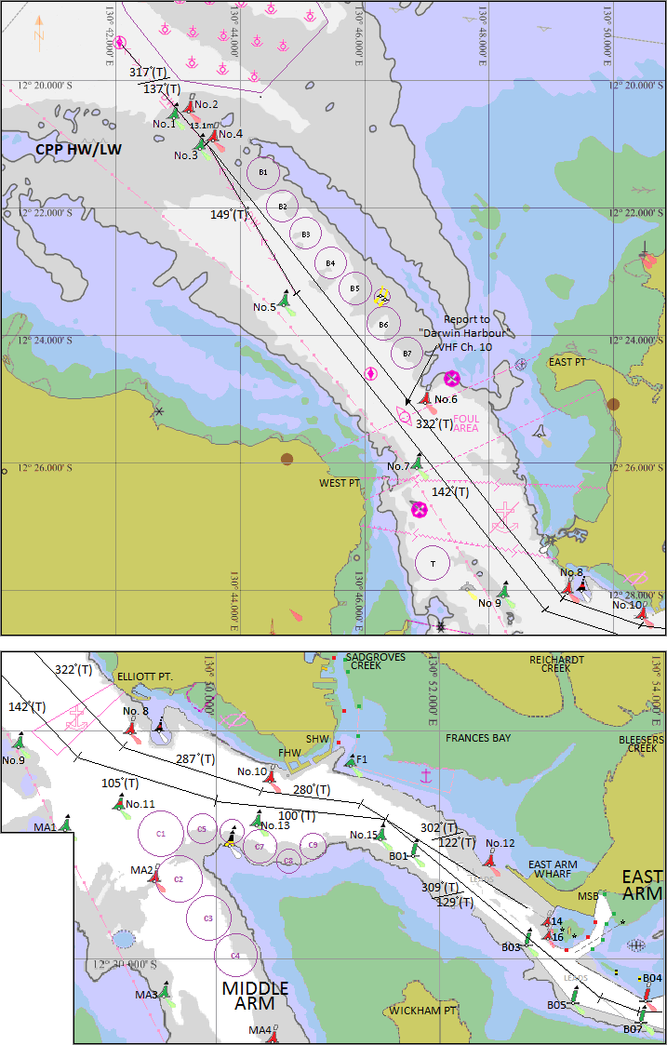
MSB PASSAGE PLAN
PIL-PP-12
Partnering in growth, connecting people and supporting potential
BRIDGE TEAM:
MAINTAIN LOOKOUT VISUALLY AND BY RADAR. FOLLOW PILOT PASSAGE PLAN AND INFORM WHEN THERE IS AN OBSERVED DEVIATION FROM THE AGREED PLAN.
*IF IN DOUBT CONSULT PILOT*
TIME
HEIGHT
HW / LW
HW / LW
PLEASE NOTE:
* THE CHARTS USED ON THIS PASSAGE PLAN ARE NOT TO SCALE. THESE CHARTS FORM PART OF THE MASTER/PILOT EXCHANGE AND ARE FOR INFORMATION ONLY. NAVIGATIONAL CHARTS AND/OR APPROVED ECDIS SHOULD BE REFERRED TO IN ALL CASES.
* INDICATED COURSES ARE A GUIDELINE ONLY. VESSEL'S ROUTE IS TO BE DISCUSSED DURING THE MASTER/PILOT EXCHANGE AND AGREED TO BY THE MASTER.
* THE SHIP'S POSITION, THE VESSEL'S CONDITION AND HARBOUR TRAFFIC ARE TO BE MONITORED THROUGHOUT THE PASSAGE BY THE BRIDGE TEAM.
* THE BRIDGE TEAM MUST IMMEDIATELY MAKE THE PILOT AWARE OF ANY CONCERNS OR ANYTHING NOT UNDERSTOOD
TUGS
PALMERSTON & STOKES
(ASD 83T)
STOCKTON & MACQUARIE
(ASD 82T)
MATARANKA
(ASD 70T)
WOYONG
(ASD 47)
Teamwork | Respect | Integrity | Honesty | Safety

